Slide 1
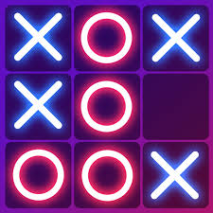
Tic tac toe
-24kb1a05nz(Mukunda)
-24kb1a05kt(Siddish)
-24kb1a05nr(Jaswanth)
-24kb1a05lu(Lokesh)

Slide 2
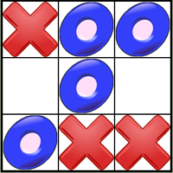
context
Tic Tac Toe in C
1. Introduction:
- Overview of Tic Tac Toe
- Importance of programming games
2. Game Features:
User input
- Win/draw detection
- Game board display
3. Implementation:
- Arrays for game board
- Functions for game logic
4. Benefits:
- Improves problem-solving skills
- Enhances programming knowledge
5. Future Enhancements: - AI opponents - GUI implementation

Slide 3
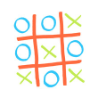
KEY FEATURES
1. Game Board Representation:
- 3x3 grid represented using a 2D array
2. User Input:
- Players enter their moves (row and column numbers)
- Input validation to ensure valid moves
3. Game Logic:
- Checks for wins (horizontal, vertical, diagonal)
- Checks for draws (all squares filled, no winner)
4. Game Display:
- Displays the current state of the game board
- Shows player symbols (X and O)
5. Player Switching: - Alternates between two players (X and O)
6. Win/Draw Detection: - Announces the winner or declares a draw
7. Game Loop: - Continues until the game is won or drawn

Slide 4
Source code
https://onlinegdb.com/F62fBdE13

Slide 5

algorithm
1.Initialize Game Board:
Create a 3x3 grid.
2. Player Move:
Get player input (row and column).
Validate input.
Update game board.
3. Check Win/Draw:
Check rows, columns, and diagonals for a win.
Check if all squares are filled (draw).
4. Switch Player: Alternate between players (X and O).
5. Repeat: Continue steps 2-4 until win or draw.

Slide 6
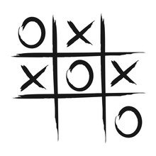
ADVANTAGES
1. Improves Problem-Solving Skills
2. Enhances Critical Thinking
3. Develops Strategic Planning
4. Improves Cognitive Function
5. Promotes Healthy Competition
6. Builds Analytical Skills
7. Fun and Engaging

Slide 7
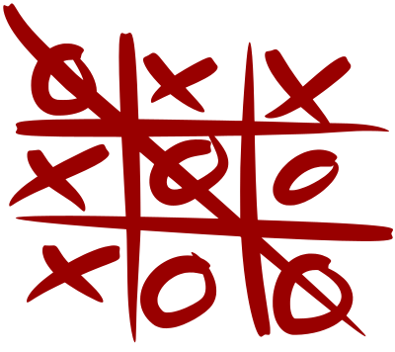
disadvantages
1. Limited Complexity
2. Predictable Outcomes
3. Limited AI Implementation
4. Graphical Limitations
5. Error Handling Challenges

Slide 8
conclusion
- Successfully implemented a console-based Tic Tac Toe game in C.
- Demonstrated key programming concepts like arrays, functions, and loops.
- Provided a foundation for further enhancements and improvements.

Slide 9
THANKYOU

